Slide 1

Algorithm Engineering Project
Team 1
Mert Saner- M.Sc. Scientific computing
Max PAUL Bähnisch - M.Sc. Computer science
Hannah Wetterau - M.Sc. Computer science

Slide 2

Programming Language Choice
In this Algorithm Engineering project, C++ programming language is used.
C++ is high-level, high-performance, object-oriented programming language.
Main advantages of C++, portability, scalability, multi-paradigm programming, low-level manipulation, and large community
C++ also provided more control over hardware aspects like memory management and CPU usage.

Slide 3

Crucial Difference of C++
The most important reason to choose C++ was the speed.
In real-world and real applications it is faster than java
Thanks to lighter memory footprint that results in better cache performance.
Particularly, for sorting and processing the data, C++ is noticeably faster.

Slide 4
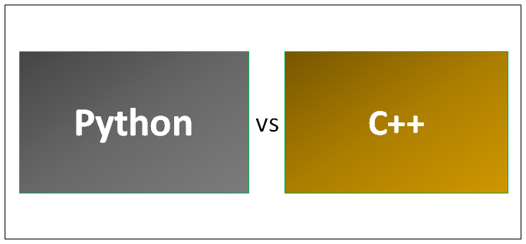
Comparison with Python
Python is interpreted, while C++ is compiled.
Compiled languages are converted directly into machine code that the processor can execute.
Interpreted code is always slower than direct machine code because it takes a lot more instructions to implement an interpreted instruction than to implement an actual machine instruction.
As a result, compiled languages tend to be faster and more efficient to execute than interpreted languages.

Slide 5
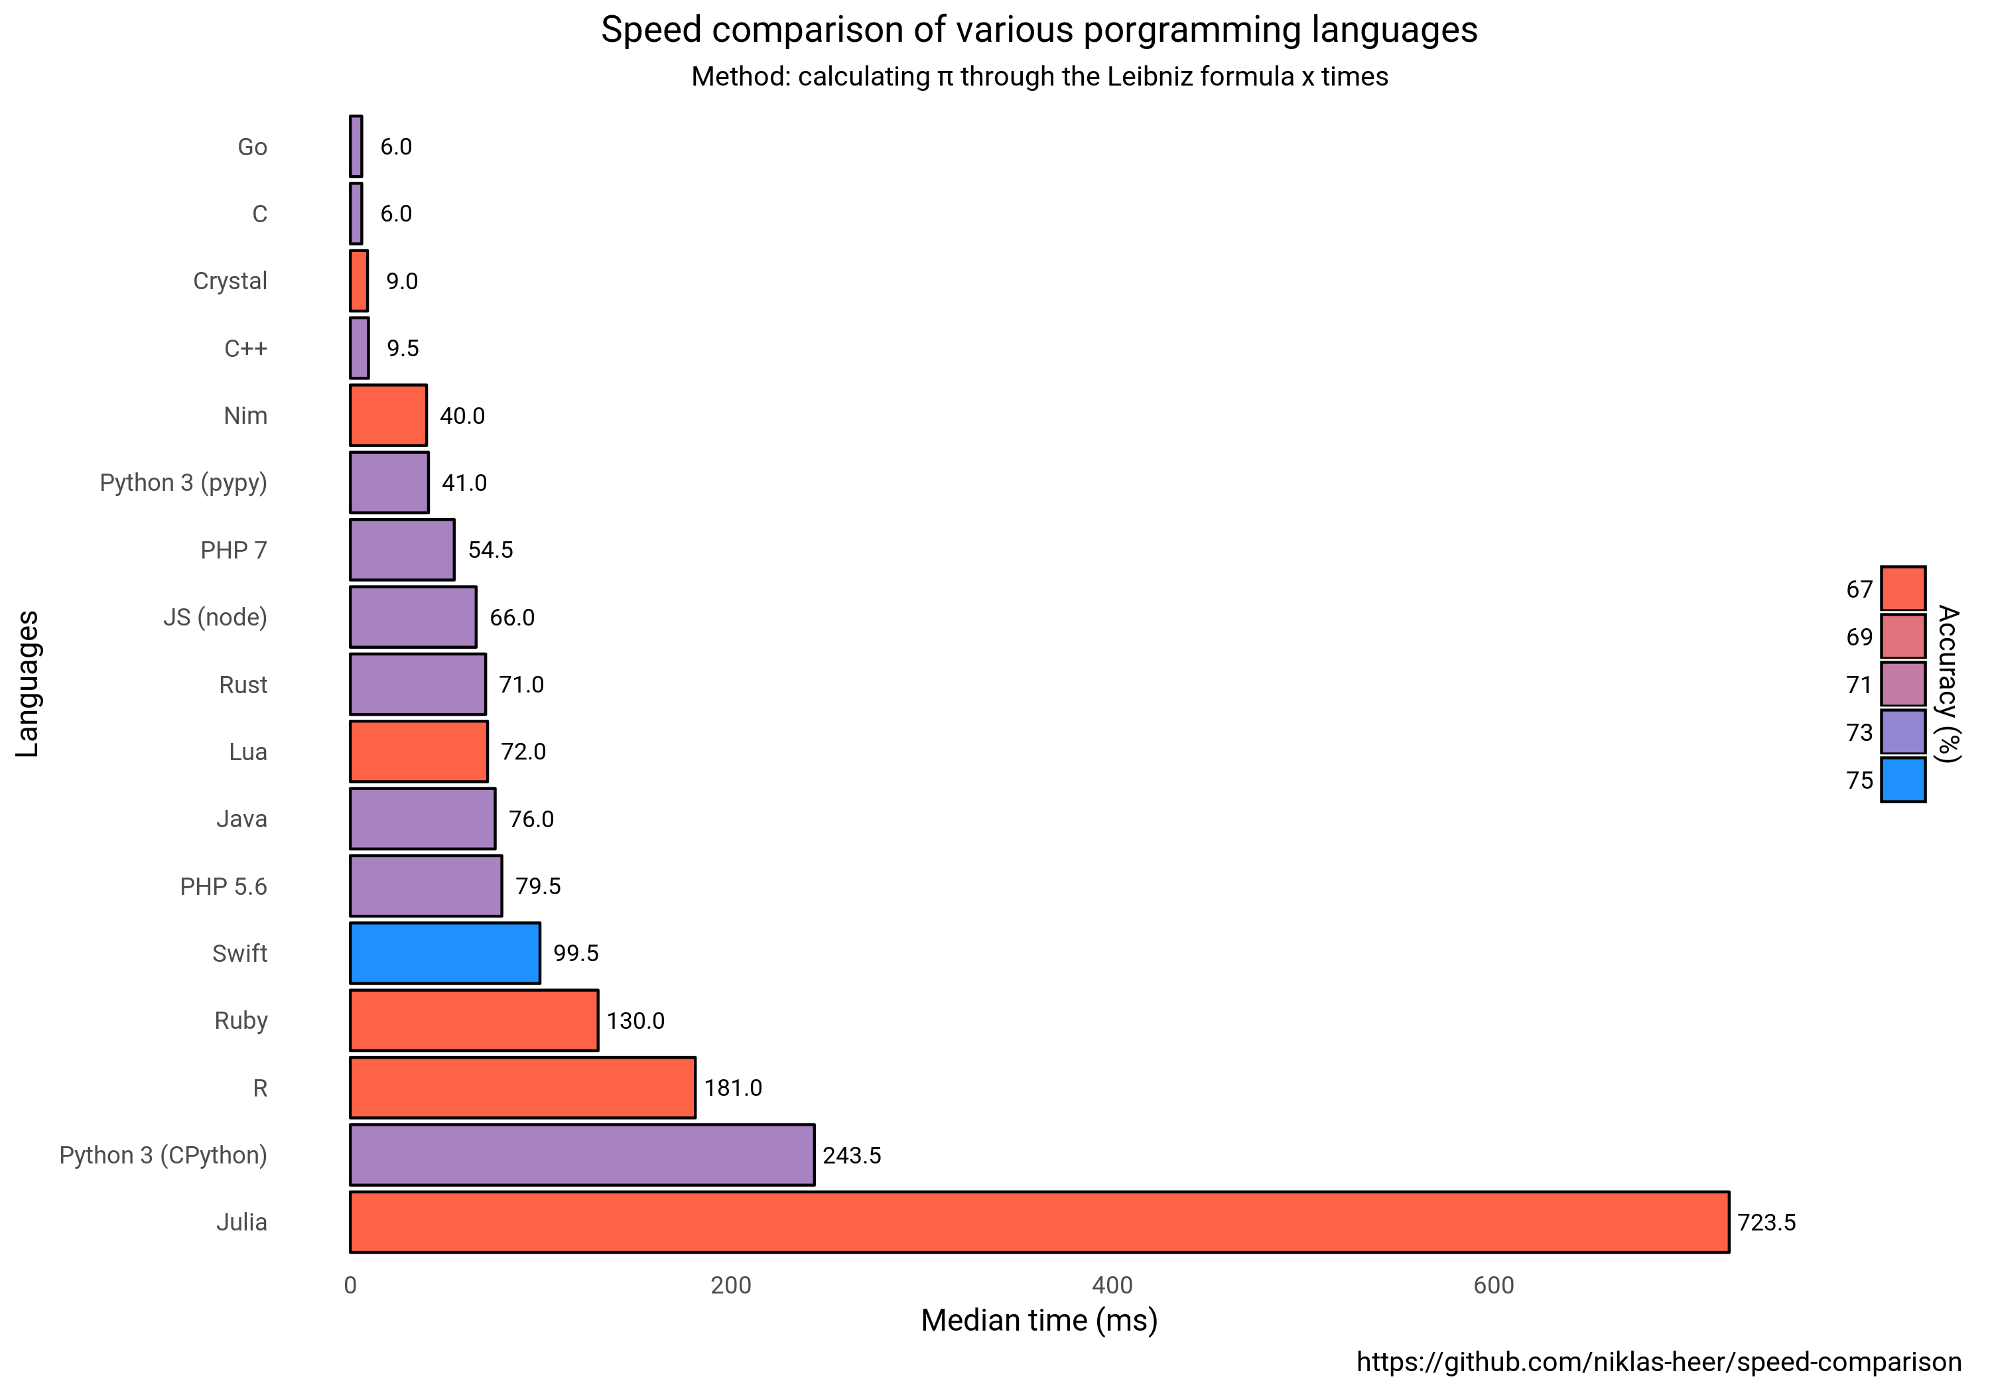

Slide 6
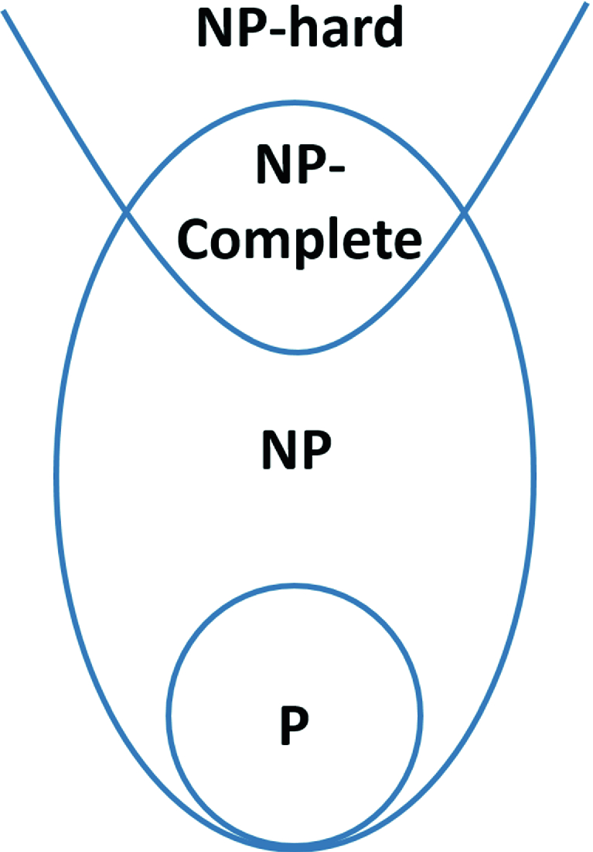
Weighted Cluster Editing Problem
The NP-hard Cluster Editing problem is among the best-studied parameterized problems.
The Cluster Editing problem is defined in a way that given an undirected, loopless graph, it is needed to find a set of edge modifications (insertions and deletions) of minimum cardinality, such that the modified graph consists of disjoint cliques.
An undirected graph G= (V, E) and a non-negative integer, the NP-hard Cluster Editing problem asks whether can be transformed into a disjoint union of cliques by modifying at most edges.

Slide 7
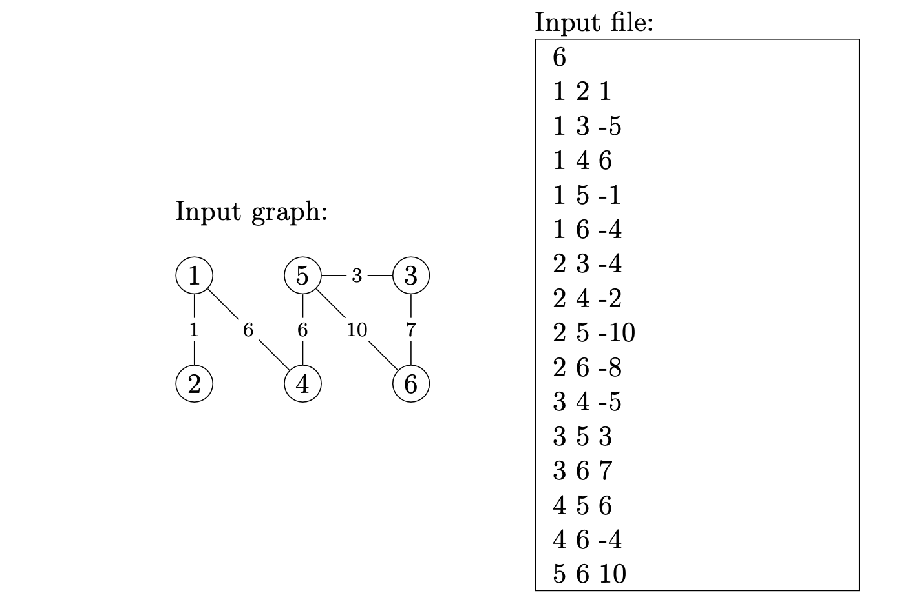
Implementation Highlights
We tried two approaches for implementation
Naïve Approach and Recursive Approach

Slide 8
Experiments
While implementing our project we created adjacent matrices and counted for a number of vertices and clusters. We also calculated the cost of each such change.
We answered one of the important questions of how does the running time depend on the number of vertices of the input graph, the answer is, for vertexcount vertices, we need to test 2^((((vertexcount - 1)^2)(vertexcount-1)) / 2) computations.
For usual computers, it would be too time-consuming to calculate.

Slide 9
Final Remarks
With the naive approach and recursive approach, the running time increases with the cost.
With each cost, we need to build a new recursive tree with one additional layer, while it depends on the cost of the vertex change.
It can be stated that our solver worked correctly to perform calculations of the cost.

Slide 10
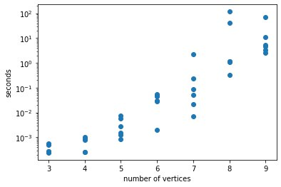
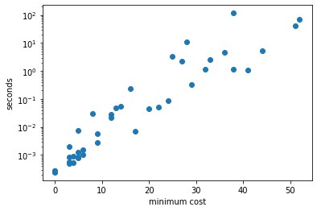
Graphs

